Slide 1






























Chatbot Architecture
A high-level overview of how our chatbot works
5
MiniLLM
HuggingFace
MLP
scikit-learn
Mistral 7B
Mistral AI
Multilayered Intent Classifier
Text Output
2.1
FAIR
2.2
NLLB-200
Meta AI
3.1
3.2
3.3
Is NOT
4.1
Is NOT
Layer 0 Gibberish
Layer 1 Out of Scope
Layer 2 Intent
Translate Back
(*if needed)
Language Detection
Translate to EN
(*if needed)
4
Unrelated
deepseek
LLM Model
1.1
1.2
Whisper
OpenAI
3.3a
3.3b
3.3c
Text Input
Voice Input (STT)
Context
Narrow
Data-driven
General
1
Fallback Message
FlashRank
CSS Huawei
START
User Query
Custom UX
Vector store
Chroma
Reranker
(*if needed)
Notes:
Our chatbot processes text and voice inputs, with language detection and multilingual support.
The query is then passed through a three-layer intent classifier where:
Layer 0 and 1 ensures the query is within municipal scope via Regex and a classifier, and if not, a fallback message is returned.
Otherwise, Layer 2 classifies the query into three intents using Few Shot prompting.
Narrow queries trigger a custom UX response.
Data-driven queries fetch vector results, optionally reranked to pass the context to the LLM.
General queries are sent directly to the LLM.
Finally, if needed, the response is translated back for the user.

Slide 2






































Forecasting Model Pipeline
How was our deep learning model crafted?
Air Quality
Keywords
FlashText
Semantic
GPT / LLMs
HDBSCAN
scikit-learn
Day of Week
Clusters
Mapping Issue
SG Issues
Is Holiday?
Hyperparameter Optimization
Rainfall
Similarity
Fuzzy Match
Rolling & Lag
Weather
Hourly Data
Open-Meteo
Temporal Features
LR Scheduler
Temperature
Growth
Early Stopping
Municipal Dataset
Density & Proximity
OSM
POIs
Merged Dataset
Enriched
Dataset
Area
Latent
Features
Facilities
One Model per Issue
Geospatial
Permutation
scikit-learn
Age
Normalize
scikit-learn
Batch Normalization
Income
Feature Selection
Encoding
scikit-learn
Correlation
pandas & SciPy
Mixed Loss
Regions
Socioeconomic
Preprocessing
Notes:
Our forecast model is designed to predict municipal issue trends at a subzone level by combining Open311 reports from US cities with external factors like:
• Weather: data like precipitation and air quality, some of which are synthesised via cluster-aware imputation as Open-Meteo has API limits, then…
• Geospatial: features such as density and proximity of POIs and facilities which are fetched via OpenStreetMap, and finally
• Socioeconomic: data including median age, and household income for each region
Then, once all datasets have been merged, we can move on to Feature Engineering, where we enhance the data further by:
• Mapping US reported issues to SG specific municipal categories using keyword similarity and optionally LLMs, while
• Creating temporal features like holiday indicators, statistics and preparation for rolling window forecasting, and also
• Latent features such as area density, growth rates etc.
• Moreover, preprocessing steps have been done such as normalization, encoding and feature selection.
Lastly, we move on to the final stage, which is Model Training, where we train deep learning models for each issue type separately, using techniques like:
• Mixed loss functions to handle different data distributions.
• Batch normalization for model stability.
• Learning rate scheduling and early stopping to optimize training.
• Hyperparameter tuning to maximize predictive accuracy.
We believe with this model along with our dashboard, can greatly assist agencies and town councils allocate resources more effectively for proactive planning, and this is because in our dashboard, we plan to provide…

Slide 3
Forecasting Model Pipeline
How was our deep learning model crafted?
Clusters
Mapping Issue
Hyperparameter Optimization
Weather
Temporal Features
LR Scheduler
Early Stopping
Municipal Dataset
Merged Dataset
Enriched
Dataset
Latent
Features
One Model per Issue
Geospatial
Batch Normalization
Feature Selection
Mixed Loss
Regions
Socioeconomic
Preprocessing
Notes:
Our forecasting model predicts municipal issue trends at the subzone level by combining Open311 reports with external,
geospatial, socioeconomic, and weather data, some of which are synthesised via cluster-aware imputation.
We then enrich the dataset by mapping U.S. issues to Singapore categories, and engineering features like
holiday effects, density growth, and socioeconomic profiles.
Finally, we train deep learning models for each issue type with mixed loss, batch normalization, and early stopping to maximise accuracy.
These forecasts are then surfaced directly through our dashboard.

Slide 4
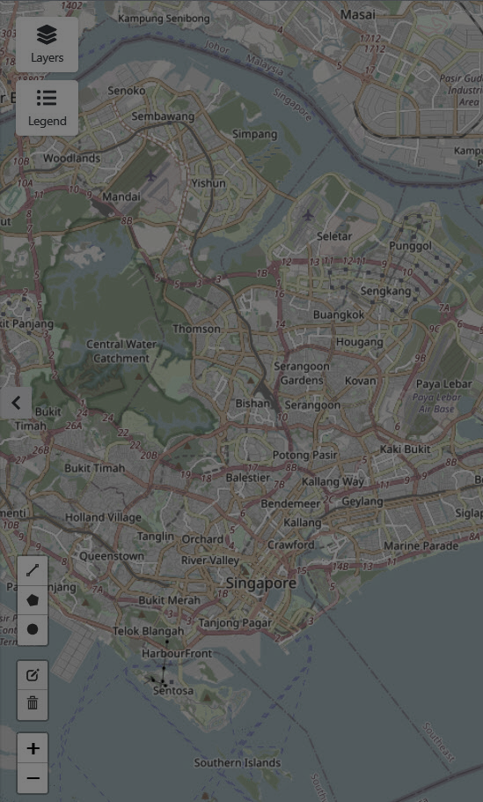

















Dashboard Items
How do we plan to flesh out our data for our consumers?
Search & Reverse Geocoding
Past & Live Issue Tracking
Filtering & Querying
Population
Breakdown
Highlight Urgent Zones
Interactive Map
Overlays
Current Weather
KPIs & Metrics
Spatial Navigation
Real-time Monitoring
Contextual Intelligence
Priortisation
Planning & Insights
Predictive Analytics
Platform Usage Intelligence
Operational Stability
Heatmaps
Correlation Risks
Window Forecasting
Service Response Estimator
User Engagement Statistics
System Monitoring Panel
Socioeconomic Graphs
Public Forum Usage
Notes:
While still in progress, our dashboard is designed to be a decision-support tool by offering:
Spatial navigation with interactive maps.
Real-time monitoring through issue tracking.
Contextual intelligence showing subzone weather and demographics.
Prioritisation by highlighting urgent zones.
Visualisations such as heatmaps and demographic breakdowns.
Predictive analytics with a seven-day service forecast.
Finally, other items may be included for operational oversight.

Slide 5
























User
Mobile App
Authentication
Cloud Diagram
OBS
Media
How do we leverage Huawei Cloud for scalability?
OBS
Hosting
API Gateway
RDS
PostgreSQL
FRONT END
REACT Native
EXPO
Tailwind CSS
SWR
Image
FunctionGraph
BACKEND
VLM
Dashboard
Chatbot
Express.js
FastAPI
PostgreSQL
VLM Model
ECS
Models
Mistral 7B
Forecast Model
Ollama
DeepSeek-R1
Notes:
Our system is cloud-native, where our front end is hosted on OBS and authenticated.
Requests are routed through API Gateway, with data stored across OBS and RDS services,
While backend tasks are processed by FunctionGraph.
Heavier workloads are containerised within SWR images in FunctionGraph,
while AI workloads are deployed on a single GPU-powered ECS instance, for low-latency inference.
We believe this architecture ensures higher robustness and scalability.

